Slide 1
Modi Flappy Bird

Slide 4
PLAY
Rate
Exit

Slide 7
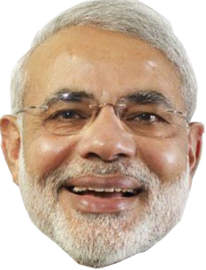
Super
Modi

Slide 8
Super
Modi
Super
Modi

Slide 9
